Slide 1
CHEF: A Configuration Management Tool

Slide 2
CONTENTS
Overview of Chef
Components of Chef
Chef Key Terms
Demonstration

Slide 3
Overview of Chef

Slide 4
Overview of Chef
Chef is a powerful automation tool that transforms complex infrastructure into code.
Chef is a configuration management tool written in Ruby and Erlang.
It uses a pure-Ruby, domain-specific language (DSL) for writing system configuration "recipes".
Chef makes it easy to deploy servers and applications to any physical, virtual, or cloud location, no matter the size of the infrastructure.

Slide 5
Overview of Chef
How does it work?
INSTRUCTIONS
Chef relies on reusable definitions known as recipes to automate infrastructure tasks.
Together, recipes describe what your infrastructure consists of and how each part of your infrastructure should be deployed, configured and managed.
FILE
Recipes use building blocks called resources.
TEMPLATE
PACKAGE
It requires three main components: a Chef Server, nodes, and at least one workstation.

Slide 6
Elements of Chef

Slide 7
Elements of Chef
Workstation
Chef Server
Nodes

Slide 8
Elements of Chef
Work station
The work station, usually a laptop, is the location from which recipes and other chef configuration files are authored and synchronized with a git repository known as Chef-Repo that stores the files.
The work station can also be used to bootstrap nodes to the Chef Server.
The Chef DK runs on workstation. It provides the tools you need for developing and testing your code locally, before deploying changes into production.

Slide 9
Elements of Chef
Chef Server
The Chef server stores your recipes as well as other configuration data.
The Chef server acts as a hub that is available to every node in the organization to make use of recipes and configuration data.

Slide 10
Elements of Chef
Node
A node can be a physical server, a virtual server or a cloud instance.
The nodes are connected to a Chef Server through a process called bootstrapping.
Once the node is connected to a Chef Server it periodically polls the Chef Server using a tool called Chef Client for the latest recipes and checks to see if the node is in compliance with the policy defined by these recipes.
The Chef Client is installed on each node in your network requiring automated configuration.

Slide 11
Chef Key Terms

Slide 12
Chef Key Terms
Knife
knife is a command-line tool that provides an interface between a Workstation, local chef-repo and the Chef server. knife helps users to manage:
Nodes
Cookbooks and recipes
Roles
Stores of JSON data (data bags), including encrypted data
Environments
Cloud resources, including provisioning
The installation of the chef-client on management workstations
Searching of indexed data on the Chef server

Slide 13
Chef Key Terms
Recipe
In chef, recipes are what you write to install and configure things on your machine like Rediss, sshd, or Apache2.0

Slide 14
Chef Key Terms
Bootstrap
Bootstrap is a process that installs the chef-client on a target node so that it can run as a chef-client and communicate with a Chef server

Slide 15
Chef Key Terms
Cookbook
A cookbook is the fundamental unit of configuration and policy distribution.
Each cookbook defines a scenario, such as everything needed to install and configure MySQL, and then it contains all of the components that are required to support that scenario.
Collection of related recipes.

Slide 16
Demonstration

Slide 17
Demonstration
Set up our workstation
Set up our Chef Server
Get a node for bootstrap
Bootstrap our node

Slide 18
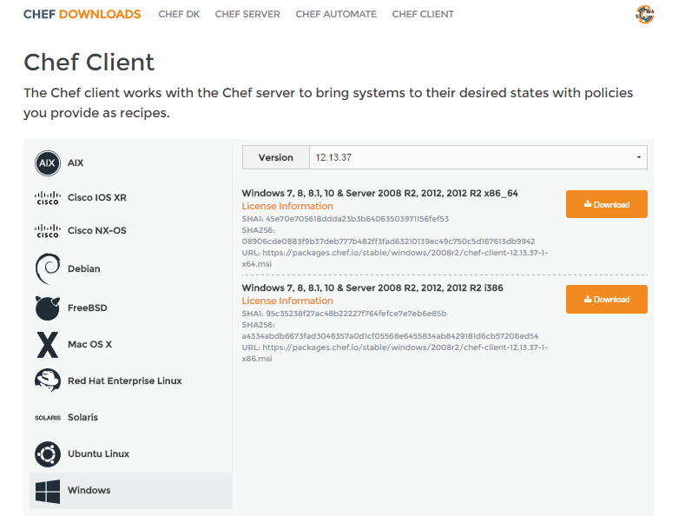
https://learn.chef.io/manage-a-node/windows/get-set-up/
https://learn.chef.io/modules/manage-a-node-chef-server/windows/hosted/set-up-your-chef-server/

Slide 19
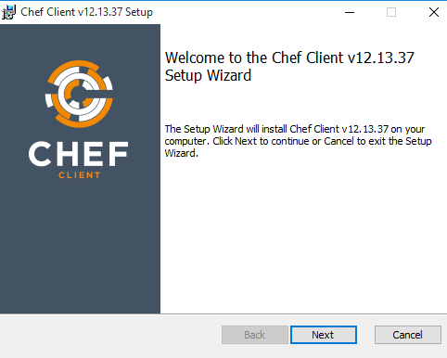
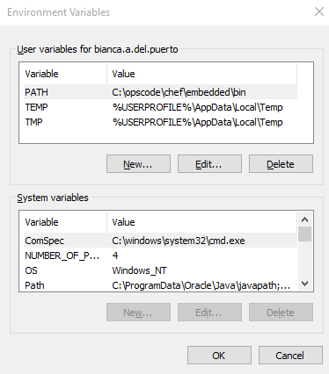
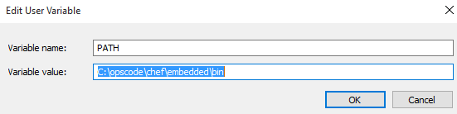
https://learn.chef.io/manage-a-node/windows/get-set-up/

Slide 20
So, what had just happened?
Workstation
Chef Server
Nodes
Chef is installed
Ruby language
Knife
Chef-client
etc

Slide 21
Demonstration
Set up our workstation
Set up our Chef Server
Get a node for bootstrap
Bootstrap our node

Slide 22
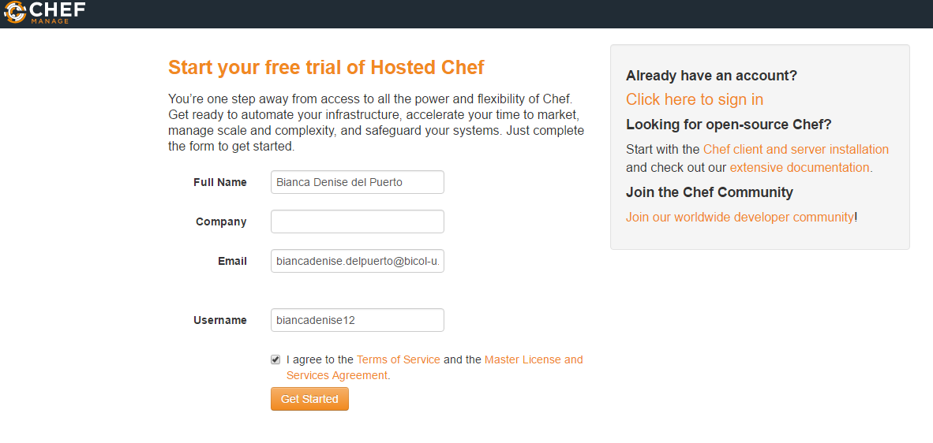
https://learn.chef.io/manage-a-node/windows/get-set-up/
https://getchef.opscode.com/signup

Slide 23
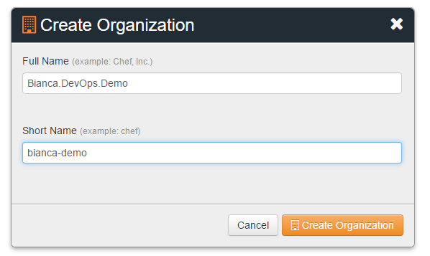
https://learn.chef.io/manage-a-node/windows/get-set-up/

Slide 24
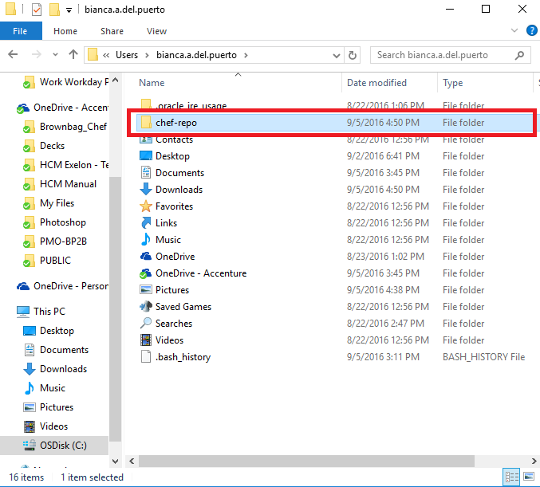
https://learn.chef.io/manage-a-node/windows/get-set-up/

Slide 25
So, where are we now?
Workstation
Chef Server
Nodes
Chef is installed
Ruby language
Knife
Chef-client
etc
Any computer that's managed by Chef is called a node.
Installed Chef Server
(optional) Install git for version control

Slide 26
Demonstration
Set up our workstation
Set up our Chef Server
Get a node for bootstrap
Bootstrap our node

Slide 27
Get a node for bootstrap
Download the evaluation version of Windows Server 2012 R2 as an ISO image.
http://care.dlservice.microsoft.com/dl/download/6/2/A/62A76ABB-9990-4EFC-A4FE-C7D698DAEB96/9600.17050.WINBLUE_REFRESH.140317-1640_X64FRE_SERVER_EVAL_EN-US-IR3_SSS_X64FREE_EN-US_DV9.ISO

Slide 28
Create a Virtual Machine
Link where you can find the steps on creating a VM:
https://learn.chef.io/modules/manage-a-node-chef-server/windows/bring-your-own-system/get-a-node-to-bootstrap#/

Slide 29
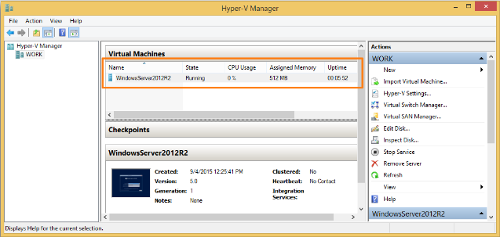
Create a Virtual Machine

Slide 30
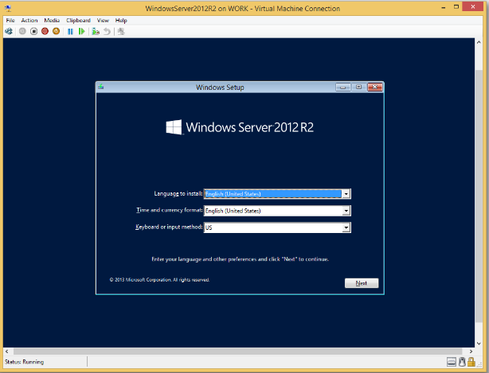
Install Windows Server 2012 R2 on your virtual machine

Slide 31
Demonstration
Set up our workstation
Set up our Chef Server
Get a node for bootstrap
Bootstrap our node

Slide 32
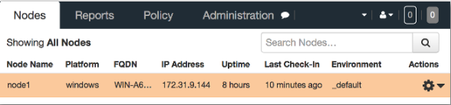
Bootstrap our node
https://learn.chef.io/modules/manage-a-node-chef-server/windows/bring-your-own-system/bootstrap-your-node#/
Confirm the result:

Slide 33
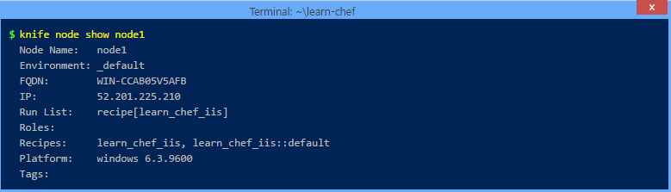
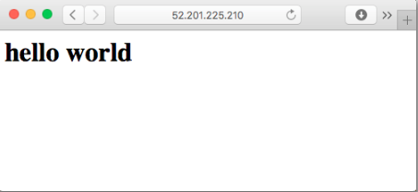
Bootstrap our node

Slide 34
So, where are we now?
Workstation
Chef Server
Nodes
Chef is installed
Any computer that's managed by Chef is called a node.
Ruby language
Knife
Chef-client
etc
Installed Chef Server
node1
(optional) Install git for version control

Slide 35
Updating our node configurations

Slide 36

QUESTION and ANSWER

Slide 37
THANKS FOR LISTENING! ☺

